Slide 1

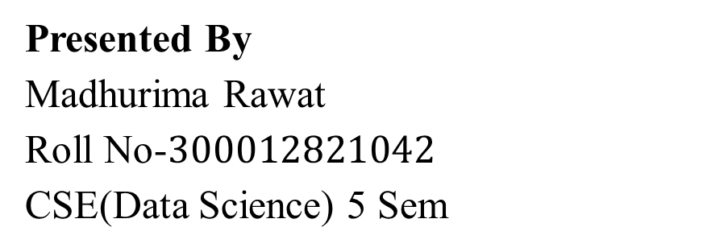
CHHATTISGARH SWAMI VIVEKANAND TECHNICAL
UNIVERSITY
VOCATIONAL TRAINING PRESENTATION
On
CREDIT CARD FRAUD DETECTION
At
Diginique Techlabs
Presented By Madhurima Rawat Roll No-$300012821042$ CSE(Data Science) 5 Sem
Course:
Data Science, Machine Learning and AI using Python

Slide 2
Index
Introduction
Technology Used
Machine Learning pipeline
Methodology
Data Preprocessing
Streamlit App Code
Output
Project Resources

Slide 3
Introduction
1. Objective: Develop a robust credit card fraud detection system using advanced machine learning techniques with hyperparameter tuning along with deployment.
2. Dataset: Utilizing the Kaggle dataset containing credit card transactions with labeled information (legitimate or fraudulent).
3. Problem Statement: Build a predictive model to effectively distinguish between genuine and fraudulent transactions by evaluating and optimizing multiple machine learning algorithms.

Slide 4



Technology Used
Machine Learning: Utilized various supervised learning algorithms with a focus on Random Forest.
Streamlit: Created a user-friendly web application for interaction and visualization.
GitHub Hosting: Deployed the app on GitHub and Streamlit for public access.

Slide 5
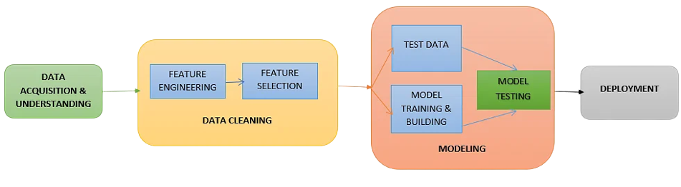
Machine Learning Pipeline
Implemented a comprehensive machine learning pipeline, including data preprocessing, feature extraction, algorithm development, model testing, data visualization, deployment via an interactive web app, and hosting for public accessibility.

Slide 6
Methodology/ Planning of work
Data Preprocessing- Addressed Class Imbalance and identification of missing data.
Feature Extraction- Extracted Input and output features and ensured Data Compatibility.
Model/Algorithm Development- Conducted EDA and found Random Forest as best performing algorithm and performed Hyperparameter Tuning.
Model Testing- Evaluated training and testing accuracy with random forest achieving the highest accuracy.
Data Visualization- Implemented dimensionality reduction and visualized algorihm performance.
Deployment- Deployed the project using Streamlit, allowing users to interact with various algorithms and see accuracy results.
Hosting- Hosted the web app on GitHub and Streamlit for public access.

Slide 7
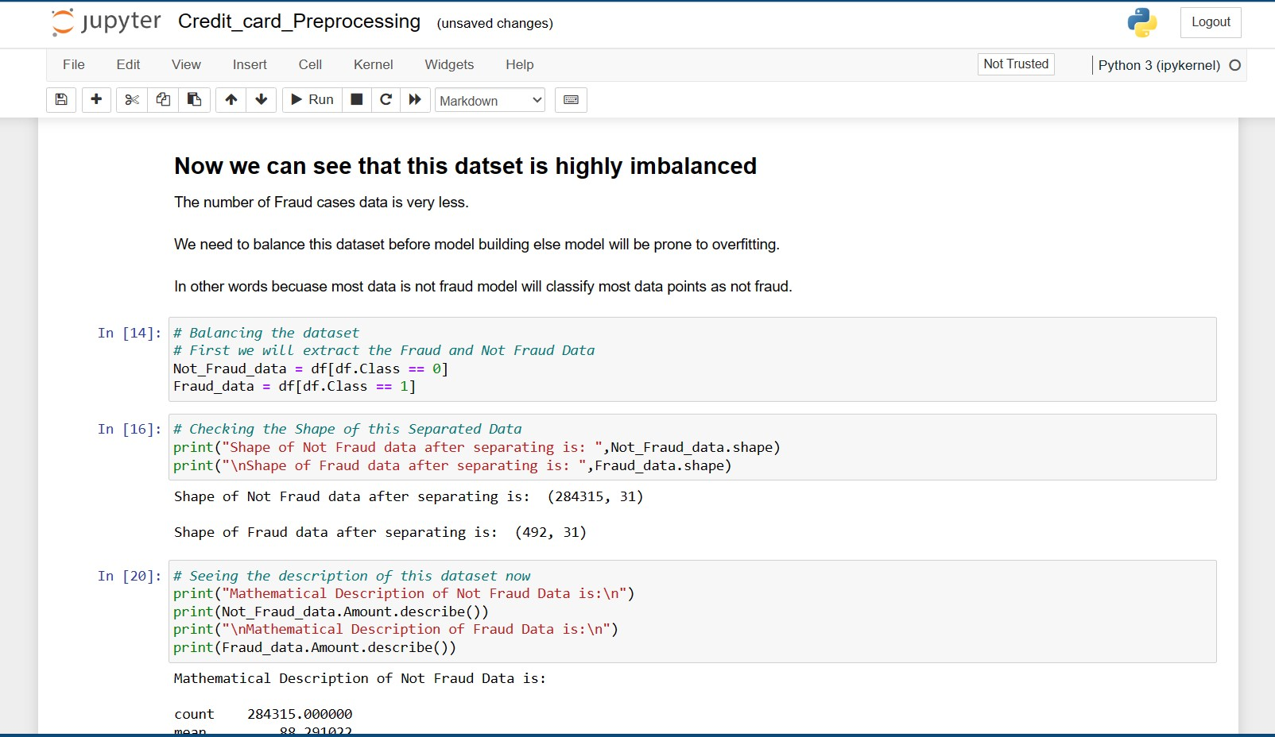
Data Preprocessing

Slide 8
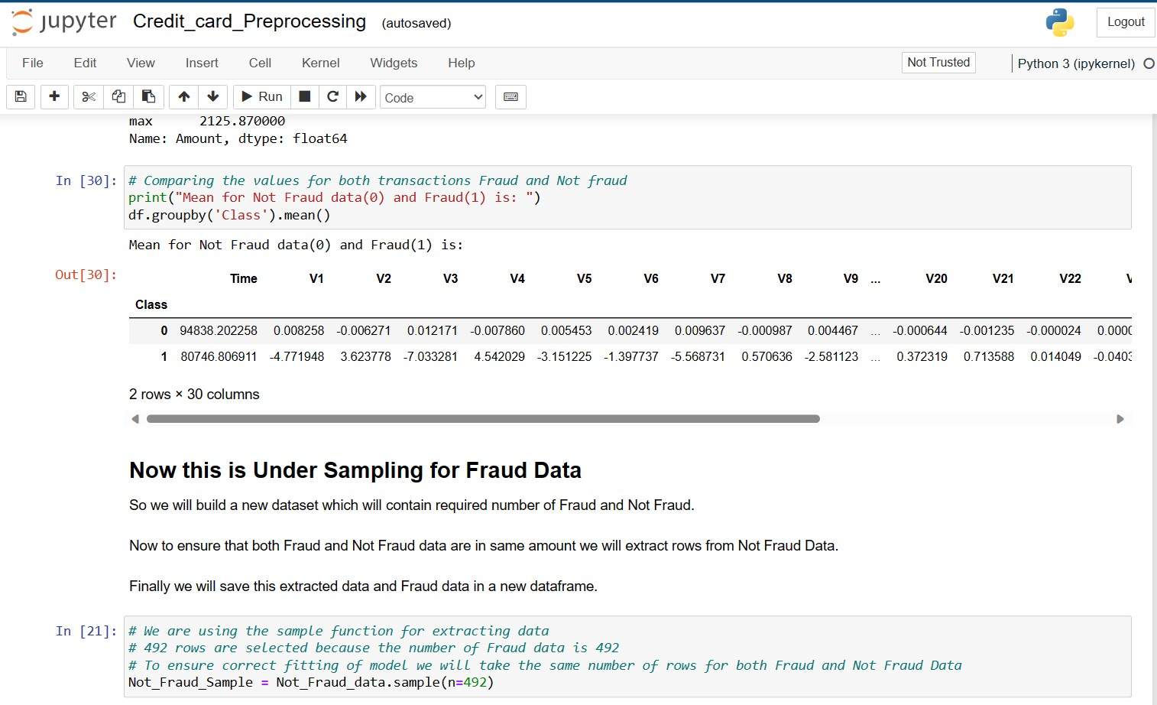
Continue...

Slide 9
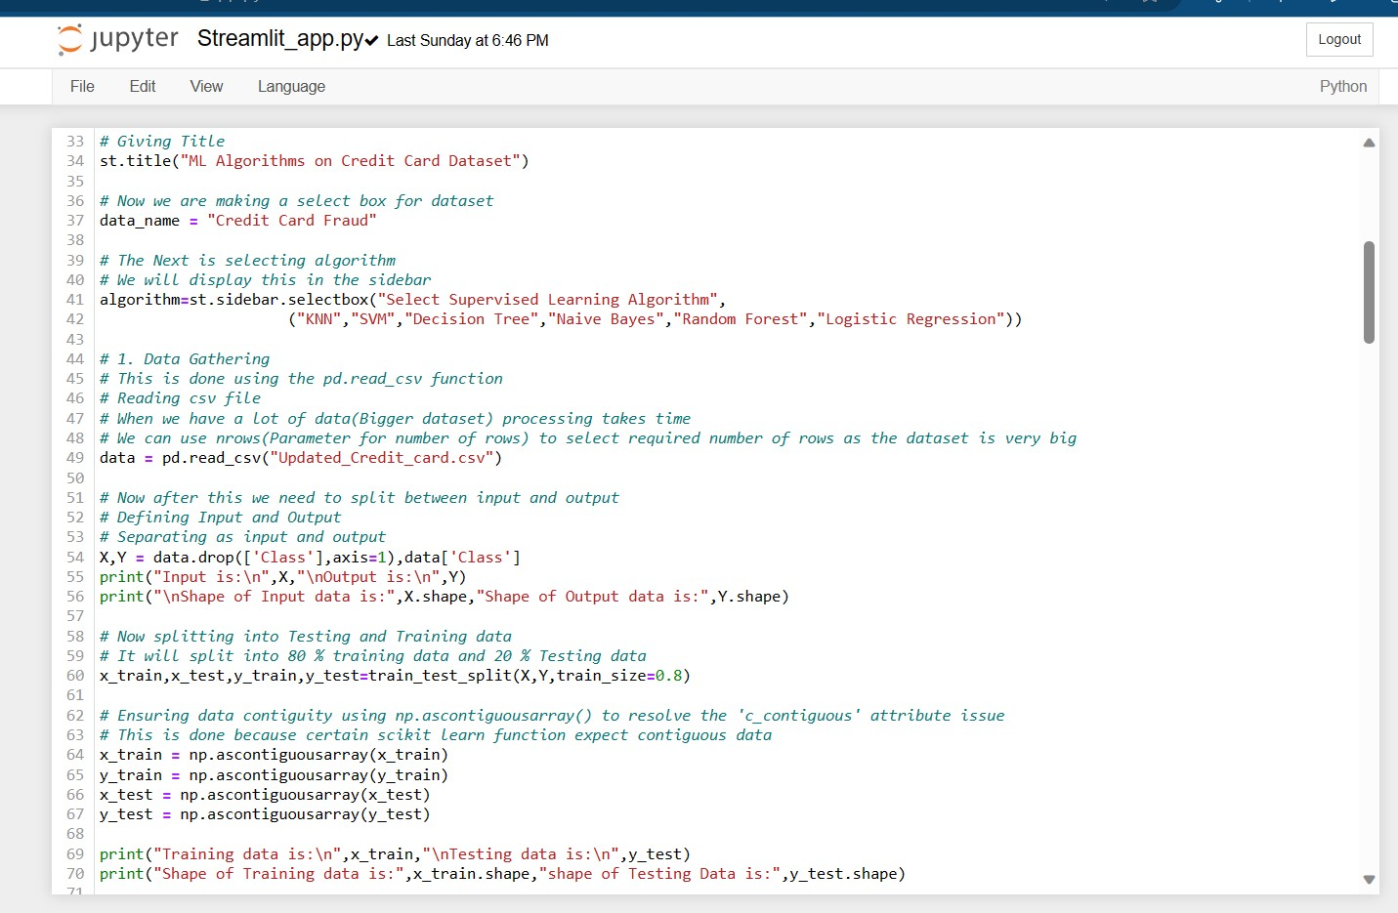
Streamlit App Code

Slide 10
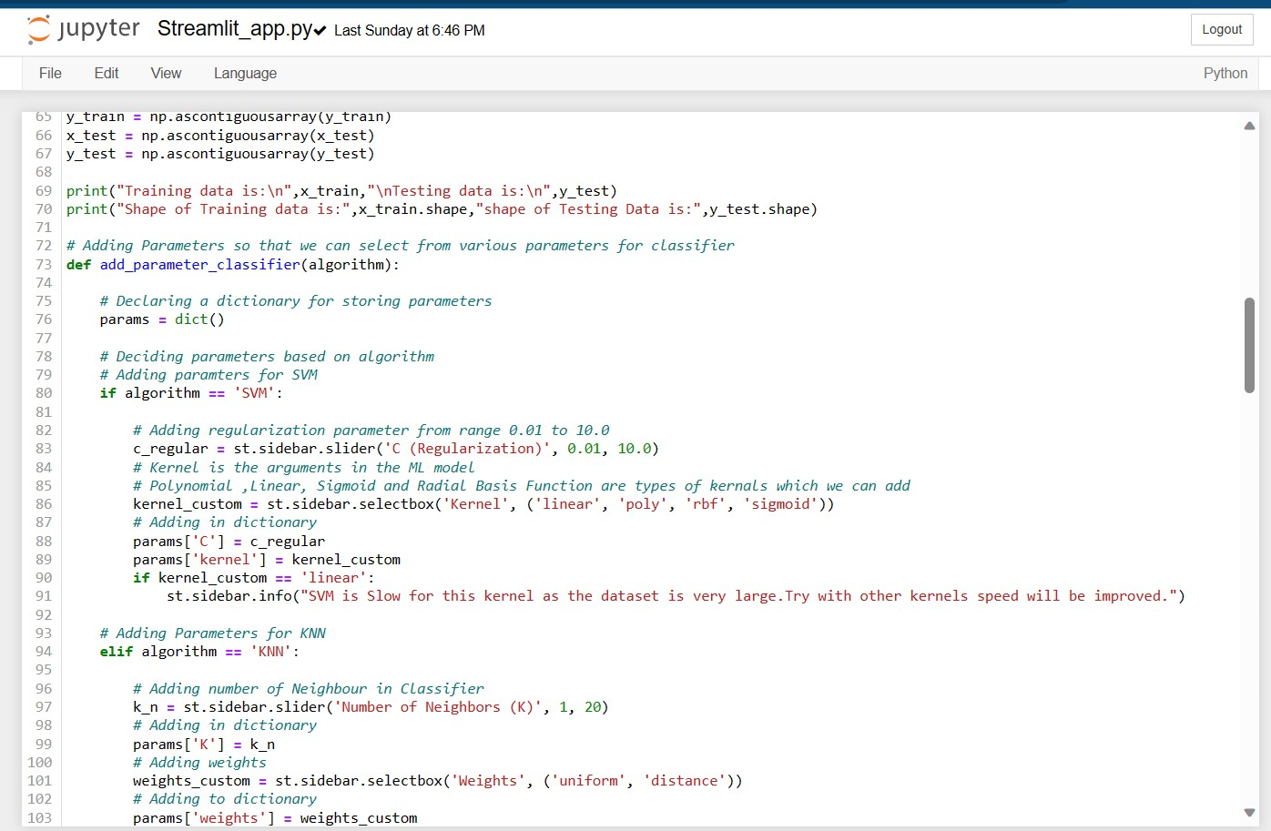
Continue....

Slide 11
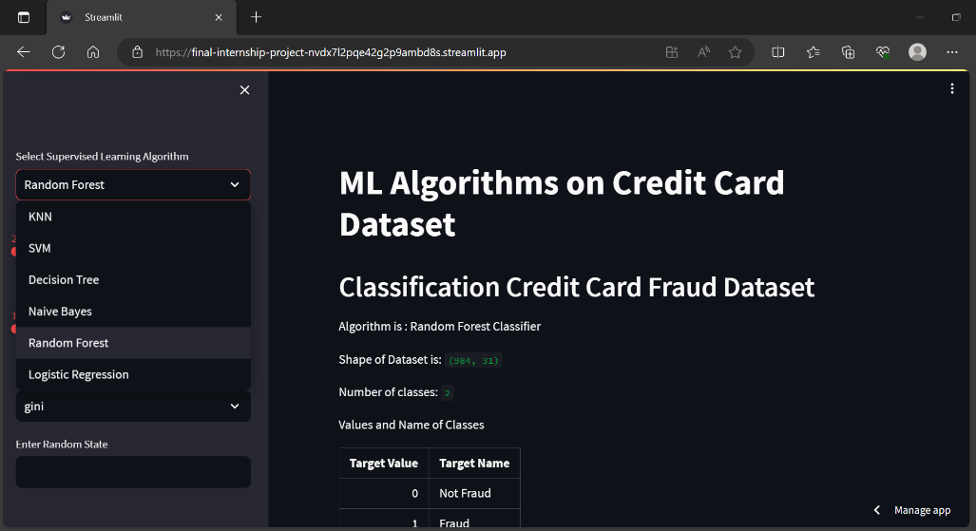
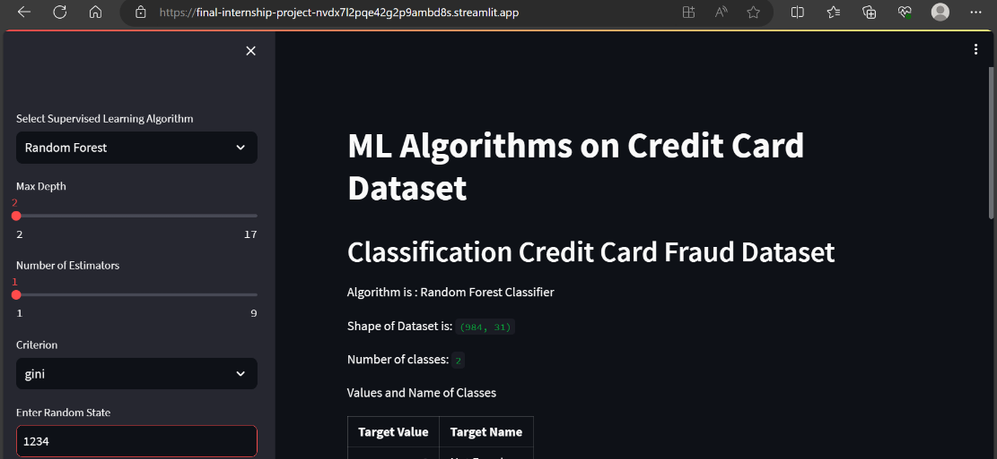
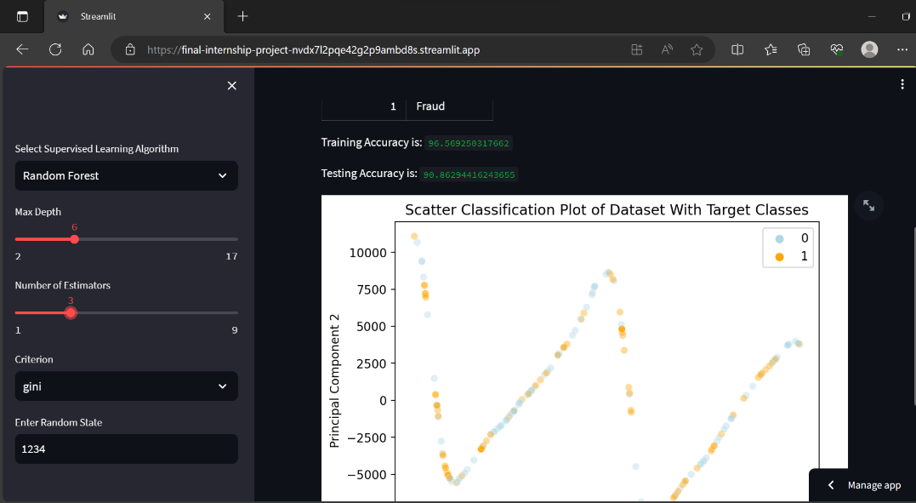
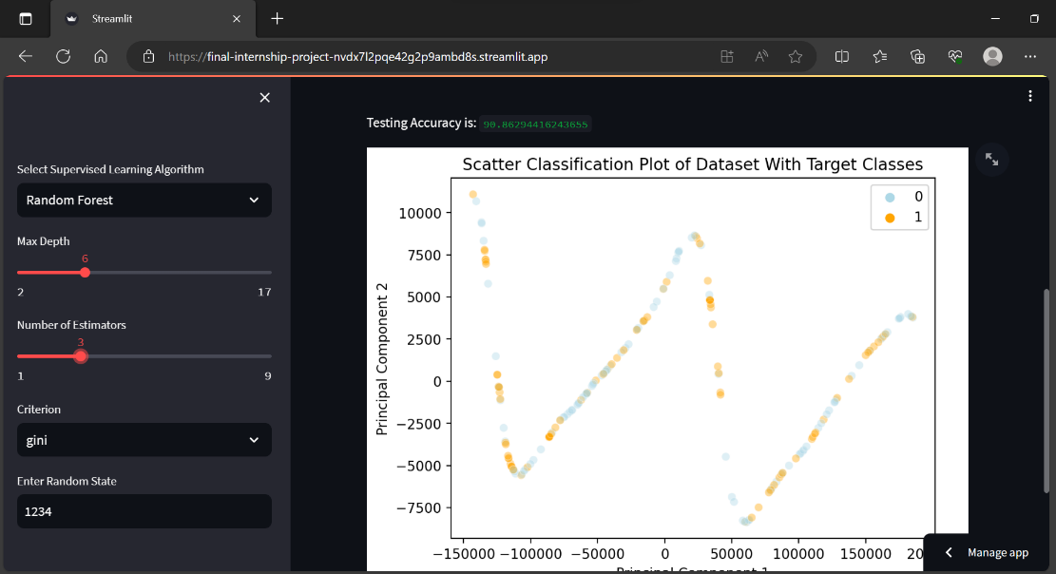
Output- Design of website

Slide 12
Project Resources
Machine learning Process: https://www.datacamp.com/tutorial/tutorial-machine-learning-pipelines-mlops-deployment
Dataset: https://www.kaggle.com/code/janiobachmann/credit-fraud-dealing-with-imbalanced-datasets/input
Deployment: https://final-internship-project-nvdx7l2pqe42g2p9ambd8s.streamlit.app/
Credit Card Fraud Detection App can be accessed from:
GitHub Repository:
Codes related to this project can be seen at my GitHub Repository:
GitHub Repository Link: https://github.com/madhurimarawat/Final-Internship-Project

Slide 13
THANK YOU FOR LISTENING TO MY PRESENTATION
Any questions?

